Slide 1
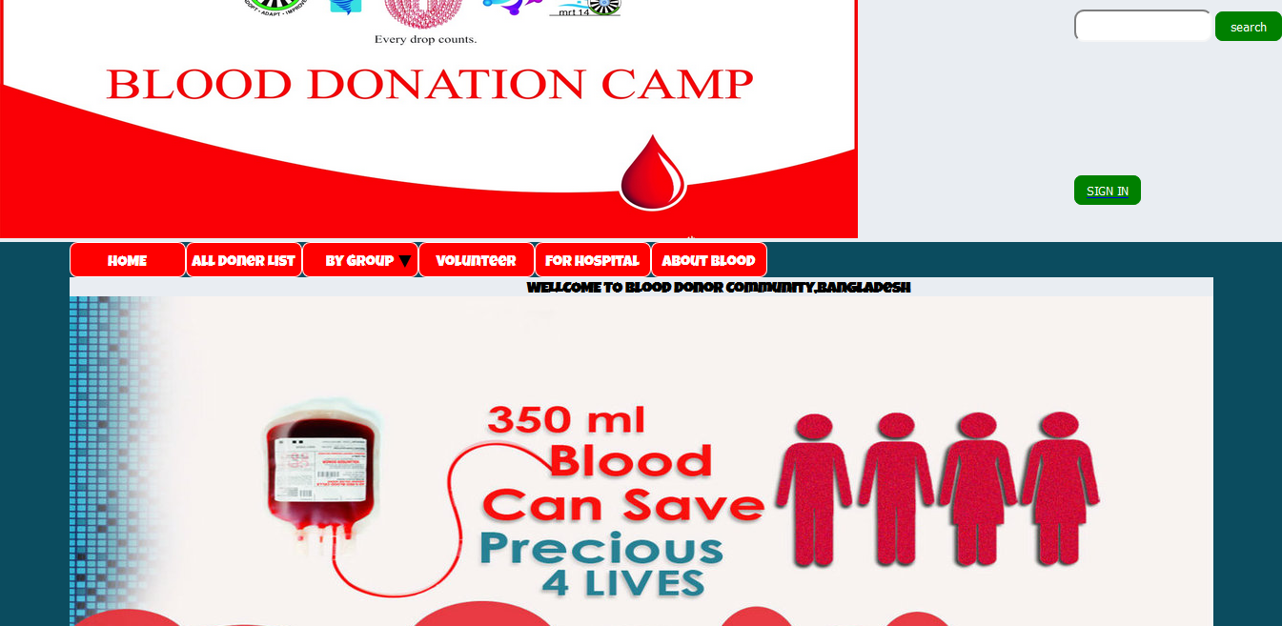
Blood Donor Management System
Md.Rafiqul Islam(15101059)
Shepon Das(15101075)
Shahariar Siddique(15101058)

Slide 2
Contents
Why we select this project ?
Platform
Features
Application advantages
Flow Chart
Future Work
Conclusion
Acknowledgement
Picture of Project

Slide 3
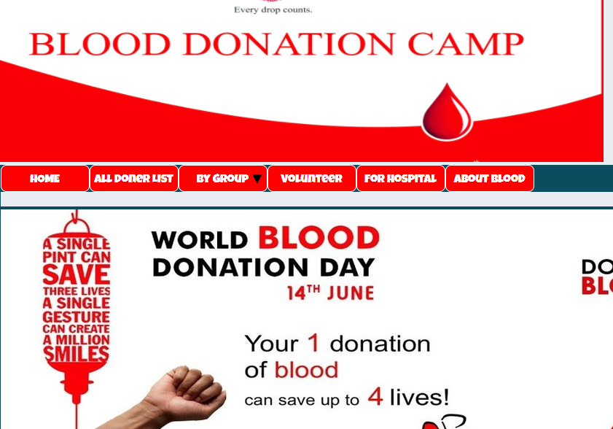
Why we select this project ?
A few days ago a blood donation camp organization come here in our university. From here onwards, the thoughts of this project come to my mind. Blood camps have been seen by volunteers calling everyone for blood. They did not have a list of who would give blood or who was physically perfect for So I have created a website for our university where there will be a list of those who will give blood and their bio data. Also, when a patient needs blood, the donor can be easily available from the website.

Slide 4
Platform
Operating System : Windows 8.1
Web Browser :Chrome, Mozilla Firefox
Designing Tool :Notepad++,HTML,Xampp
Client Side Scripting :CSS,HTML,PHP

Slide 5
Features
Home page
Registration page
Login page
Search bar
Search for blood by Blood group
All donor info show
Donor Info update and delete

Slide 6
Application advantages
The people in need of blood can search for the donors by giving their blood group and city name. it saves time as he can search donors online without going anywhere. Using this system user can get blood in time and can save his relative or friend life. Our website work 24x7 so user can get information of blood donor any time. Blood donor can also get registered and save life of other person. The main benefit of this system is the information of available blood group.

Slide 7

Flow Chart
Home Page
Blood Donner
Blood Seeker
Registration
Donner Search
Login Page
Contacts
Modification
General Info
Service

Slide 8
Future Work
The proposed System is “Blood Dono Management System". We can enhance this by including more facilities like Uk.blood donotion.com blood donation website for the stock details of blood in the bank providing such feathers enable the users to include more comments into the system

Slide 9
Conclusion
The project Blood Donor Management System is for computerizing the working in a our Univarsity. It is a great improvement over the manual system.. The Blood Donor Management System was thoroughly checked and tested with data and thus is found to be very
fast.

Slide 10
Acknowledgement
The satisfaction that accompanies that the successful completion of any task.
Whose content guidance and encouragement crown all efforts with success
We are grateful to my project guide Dr. Md. Rajibul Islam
for the guidance ,inspiration and constructive suggestions that helpful my in the preparation of this project

Slide 11
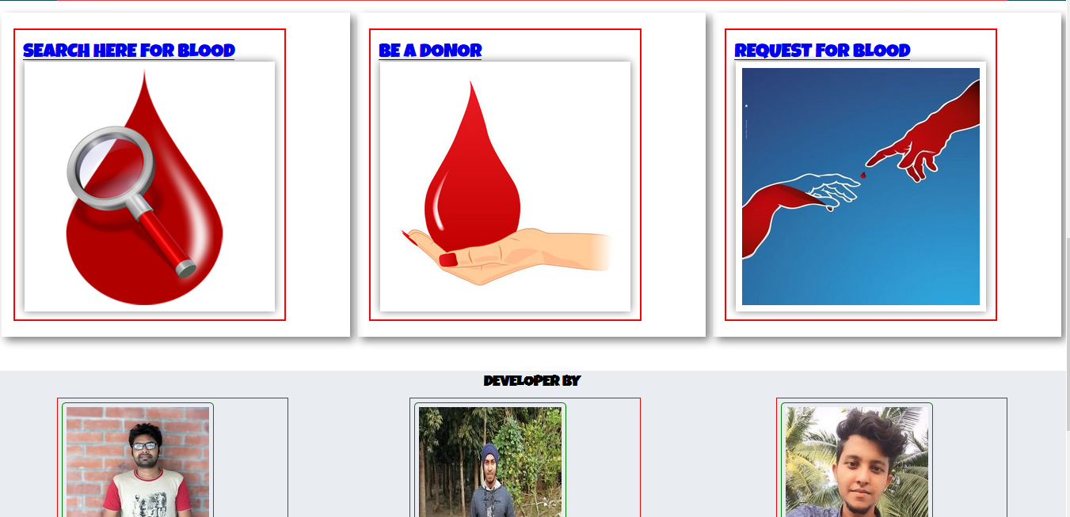
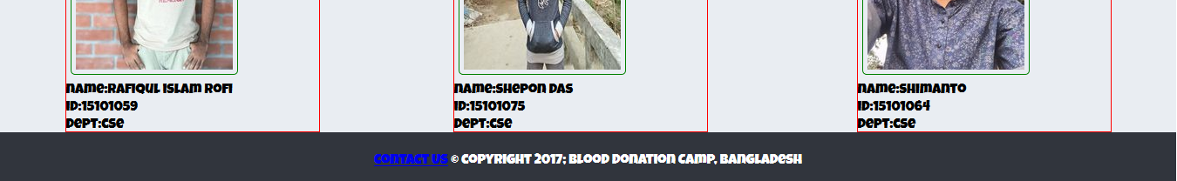
HOME PAGE

Slide 12
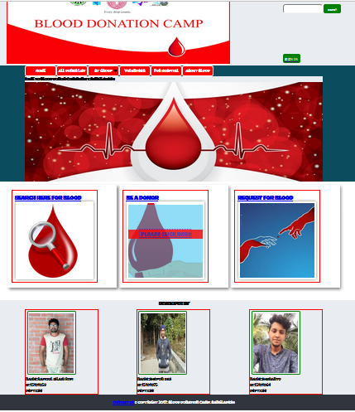
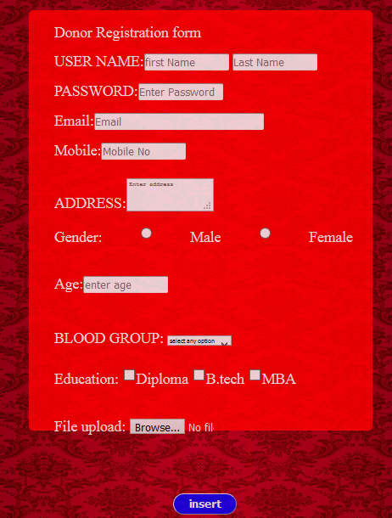
Registration Page
Anyone can easily registration our website with proper bio data and image.

Slide 13
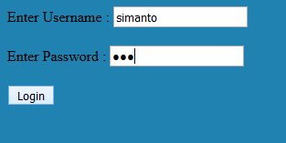
Login Page
Donner login their id with proper data like name and password.

Slide 14
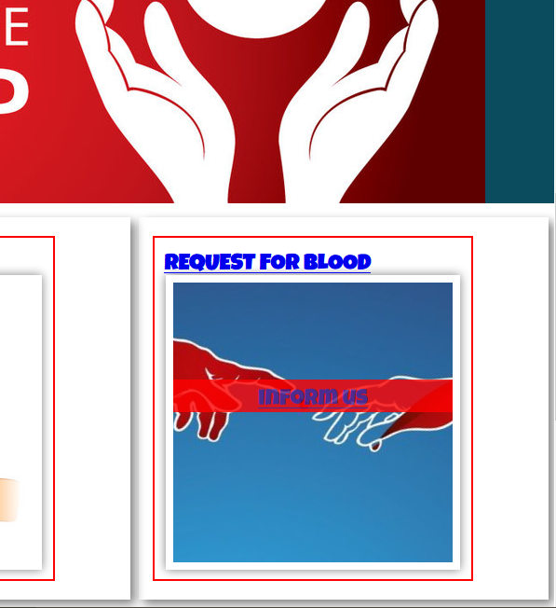
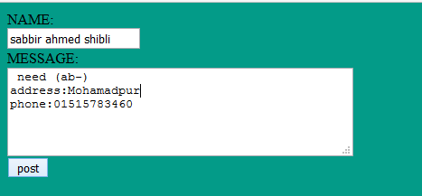
Blood Request page
Anyone who has need advance blood they can easily post our website. This post is visible our admin panel.

Slide 15
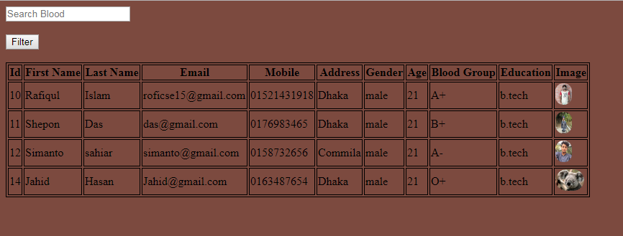
Search for Blood
We can direct search the donor of any type of blood group.

Slide 16
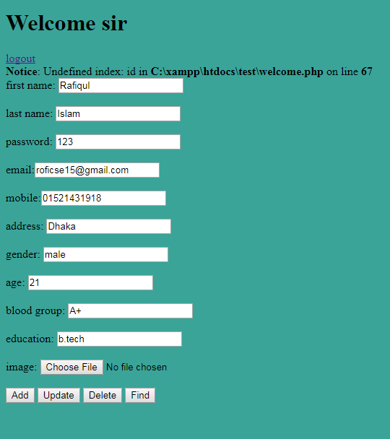
Search Donor Info
Find the donor address their phone number and easily communicate them.

Slide 17

The End

